Slide 1
AAQEP
Initial Accreditation Review Pathway
October 12, 2023
Always Improving Together

Slide 2
Welcome and introductions
Sungti Hsu, Chief Relations Officer, AAQEP
Dr. Ashley Zehner, Professor of Special Education, Muskingum University

Slide 3
Agenda
About AAQEP
The Initial Accreditation Review
Initial Accreditation Report (IAR) Outline
Logistics of the Virtual Site Visit and Accreditation Decision

Slide 4
About AAQEP

Slide 5
AAQEP: Reframing our profession’s conversation
Designed in 2017 by professionals in the field including EPP deans, faculty, P-12 educators, & SEA staff from 14 states
Working groups collaborated on
Expectations (standards and evidence)
Process (maximizing collaboration and learning)
Consistency (ensuring accuracy and transparency)
Notes:
AAQEP is a part of this larger story, and represents a fundamental re-thinking and re-imagining of the role that national accreditation can play as part of a three-way partnership with institutions and state authorities. Here’s how we got started.
43 individuals:
34 faculty, deans, staff
2 PK-12 educators
4 reps from 3 SEAs
3 AAQEP initial staff
39 institutions in 14 states

Slide 6
AAQEP vision and mission
VISION | MISSION
Excellent, effective, innovative educator preparation that is committed to evidence-based improvement, engages with the P-20 system, and holds high public confidence. | To promote and recognize quality educator preparation that strengthens the education system’s ability to serve all students, schools, and communities.

Slide 7
Principles supporting the conversation
Collaboration
Collaboration rather than competition among providers moves educator preparation forward.
Innovation
Innovation is integral to the continuous improvement cycle.
Partnership
Partnerships among providers, state authorities, and AAQEP support mutually beneficial work.
Comprehensiveness
A comprehensive system serves all providers with the same quality expectations.

Slide 8
Principles (cont.)
Context
Context and institutional mission are recognized and respected.
Consistency
Consistency and calibration of reviews and decisions are critical to their credibility.
Efficiency
Operations maximize efficiency and strive for frugality while maintaining quality.
Sharing
Broad dissemination of findings and innovations benefit the field as whole.

Slide 9
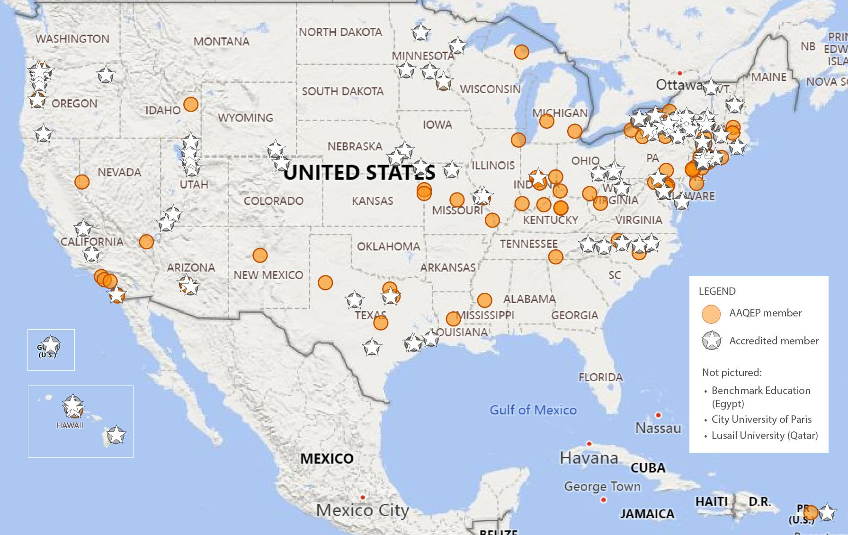
AAQEP today 200+ members, 100+ accredited, 37 states/jurisdictions
CHEA Recognized in 2021
This diverse provider population includes:
Initial
Advanced
Doctoral
Traditional
Alternative
Online
Large, medium, & small
Public
Independent
Regional
Community colleges
Land grant institutions
Notes:
We have 201 members that are educator preparation providers in 37 states and other jurisdictions. Of those, 104 (or 54% of our regular members) are now accredited, in 15 states & jurisdictions.
Updated: 10/10/2023

Slide 10
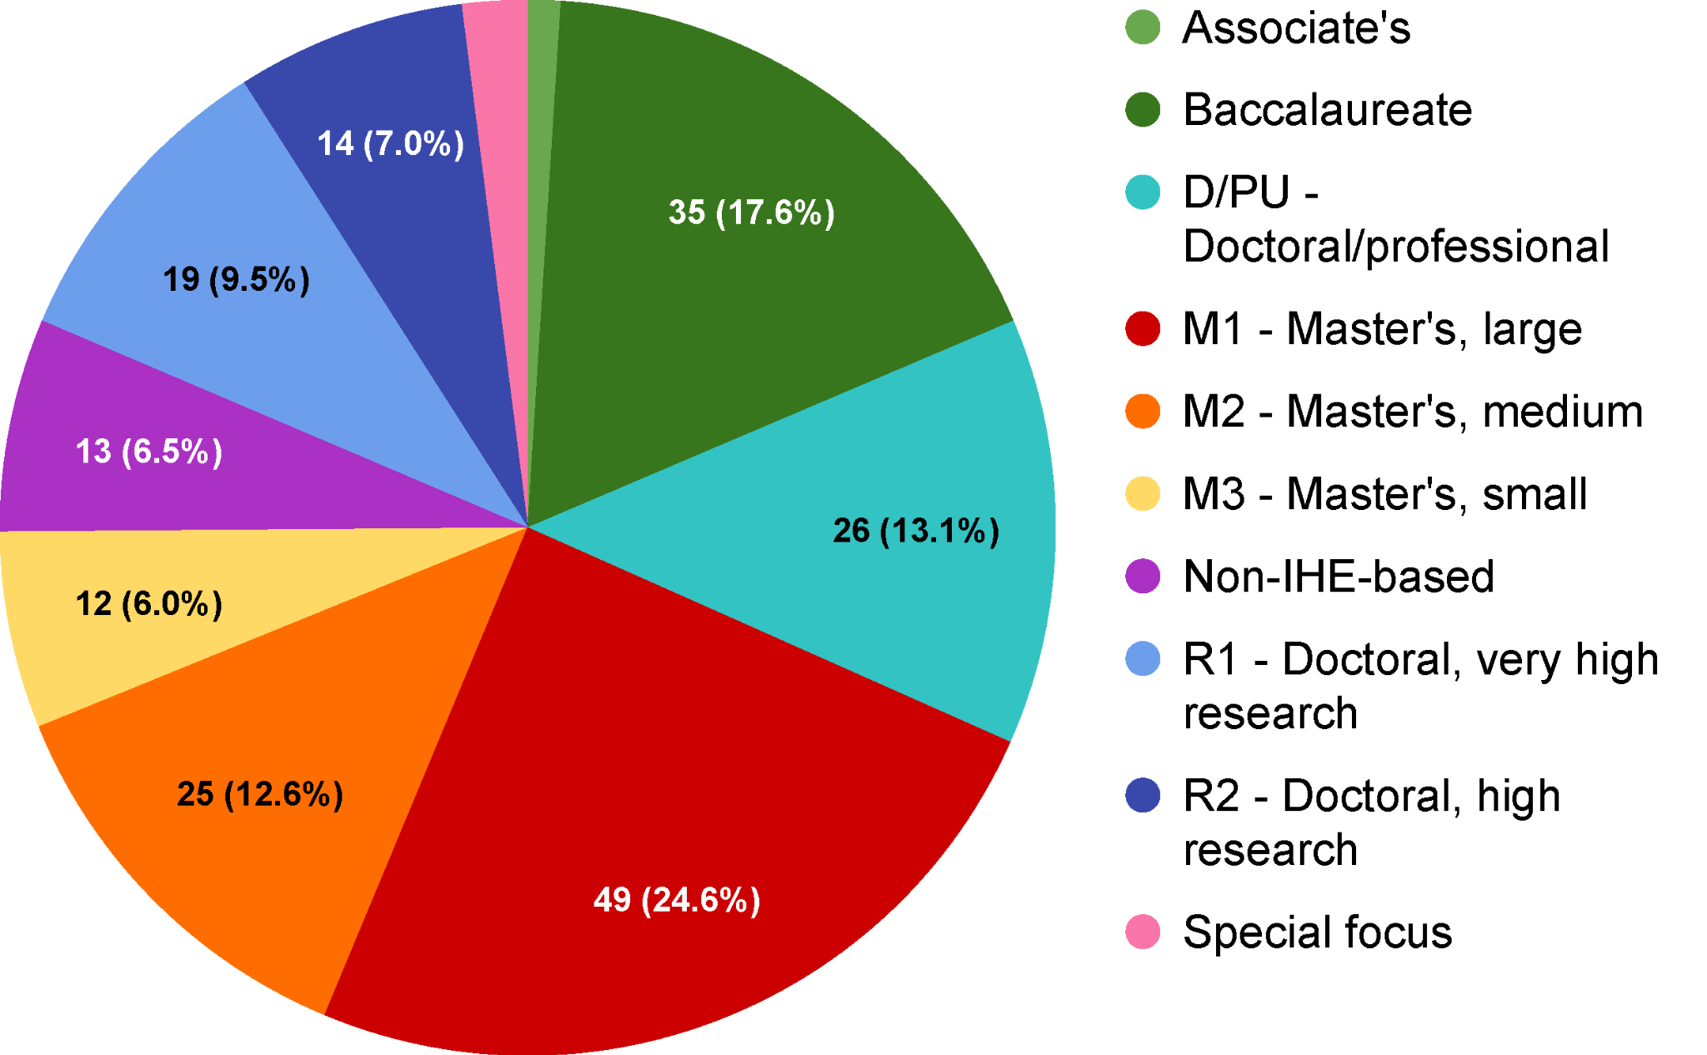
Member types
Notes:
Updated 10/03/23

Slide 11
AAQEP’s Expectations: Standards, Aspects, Evidence

Slide 12
Accreditation as a professional conversation
Accreditation: a profession’s conversation with internal and external stakeholders on critical questions about quality.
How is it defined, and what are its dimensions?
How is it identified, measured, and recognized?
How can it be increased or enhanced? (improvement)
How can we generate and understand innovation?
QUALITY
Notes:
Emphasize that the value added in national accreditation is participation in this conversation and the challenge, support, and growth that it entails

Slide 13
Accreditation = affirmation of key questions
At the end of the program, are completers ready to fill their target professional role effectively?
Were completers prepared to work in diverse contexts, have they done so successfully, and are they growing as professionals?
Does the program have the capacity to ensure that its completers are effective educators from the start and keep growing as professionals?
Do program practices strengthen the P-20 education system in light of local needs and in keeping with the program’s mission?
Notes:
Animated slide.

Slide 14
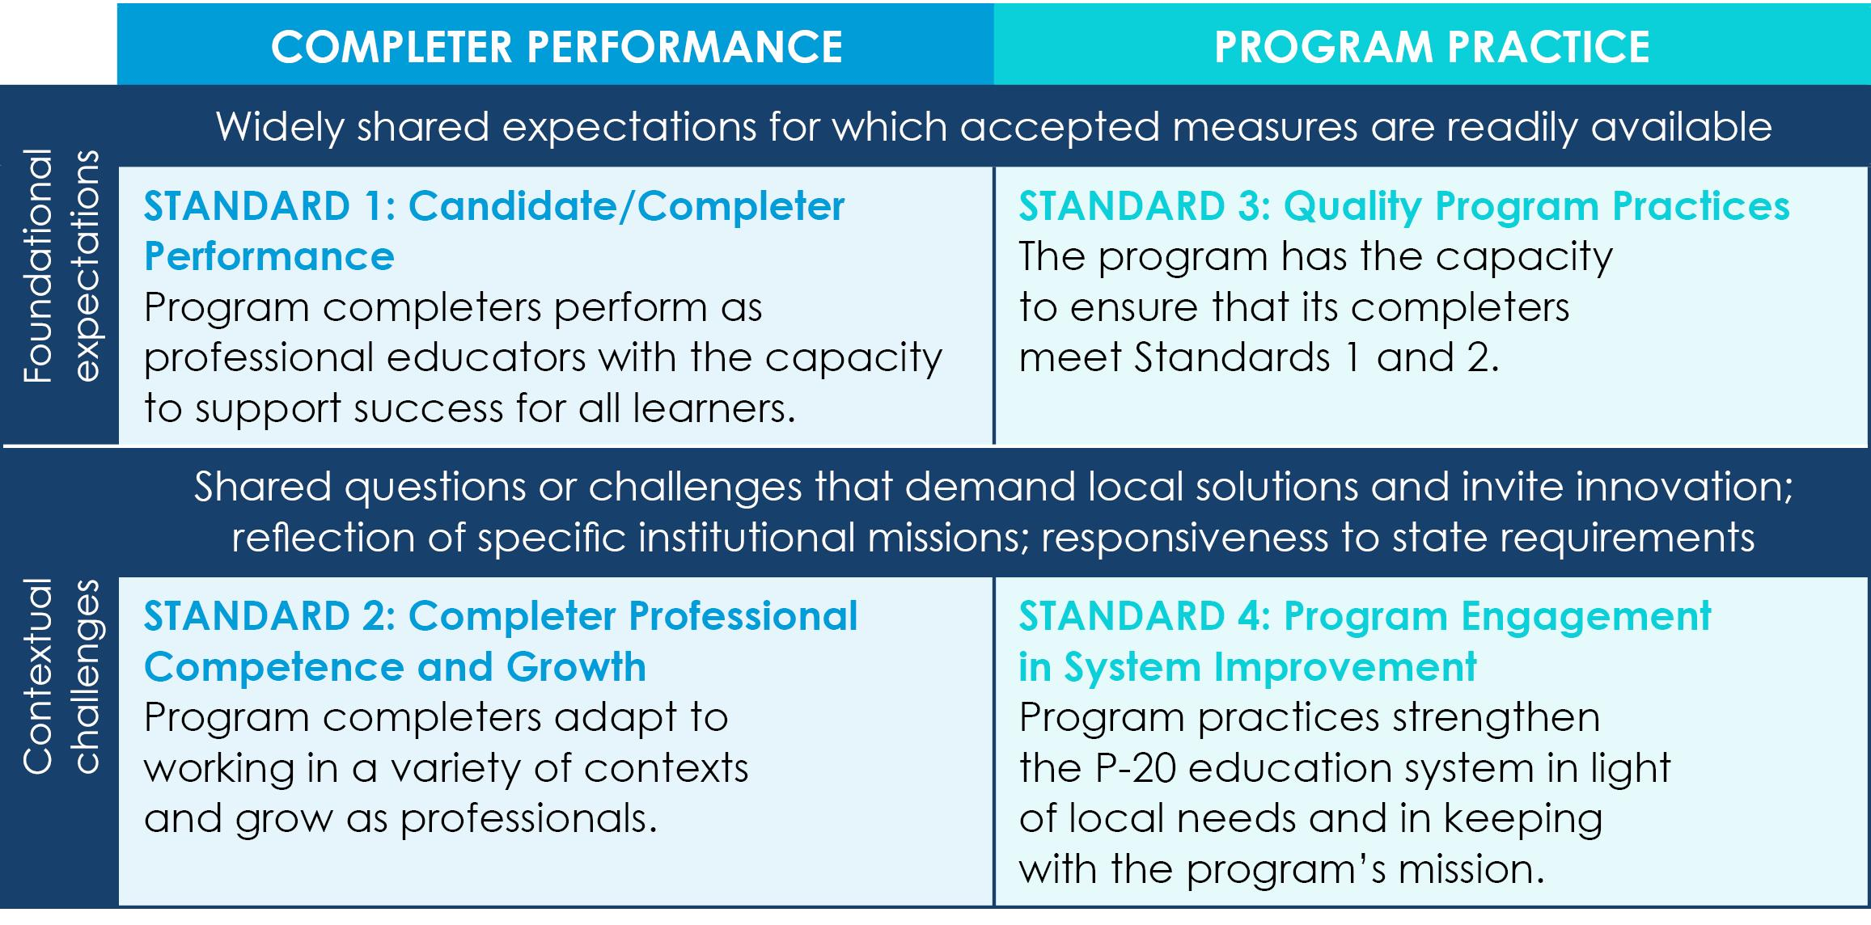
AAQEP standards: Dimensions of quality

Slide 15
Aspects* of candidate/completer performance Readiness for effective practice (Standard 1)
1a. Content/pedagogical/professional knowledge 1b. Learners/learning theory, including social/emotional learning
1c. Culturally responsive practice
1d. Assessment and data literacy, use of data to differentiate
1e. Positive learning/work environment
1f. Professional dispositions/behaviors
* See the Guide to AAQEP Accreditation for each aspect’s full description.

Slide 16
Aspects* of completer prof. competence & growth Engagement in professional practice (Standard 2)
2a. Engage local school and cultural community, caregivers, and families
2b. Culturally responsive practice with diverse learners in diverse settings
2c. Can develop productive learning environments in diverse contexts
2d. Support increasing P-12 students’ global/international perspectives
2e. Grow professionally / set goals / guide own professional development
2f. Collaborate for professional learning with colleagues
* See the Guide to AAQEP Accreditation for each aspect’s full description.

Slide 17
Aspects* of quality program practices Program capacity (Standard 3)
3a. Coherent curriculum aligned to national or state standards
3b. Quality clinical experiences in documented, effective partnerships
3c. Stakeholder engagement in analysis, planning, improvement, etc.
3d. Admission/monitoring process linked candidate to success
3e. Internal quality assurance/continuous improvement (w/ good data)
3f. Capacity for quality and institutional commitment to the program
* See the Guide to AAQEP Accreditation for each aspect’s full description.

Slide 18
Aspects* of program engagement in system improvement Strengthening the P-20 system (Standard 4)
4a. Engages stakeholders to support schools and reduce disparities
4b. Supports diverse educator workforce/addresses state and local
needs
4c. Supports completer career entry and growth
4d. Uses available evidence on completers for program improvement
4e. Meets relevant regulatory requirements
4f. Investigates effectiveness vis-à-vis institutional mission
* See the Guide to AAQEP Accreditation for each aspect’s full description.

Slide 19
Evidence requirements & priorities
Multiple measures with reasonable continuity with multiple perspectives
Quality of evidence must be investigated and shared
Priority is given to direct performance measures
Indirect and downstream measures must be considered
Differentiation of evidence by license, level, location, and mode
Assessments appropriate to the program and context
Clear indication of performance expectations for assessment measures
Notes:
Animated Slide!
Turnover to fellow presenter

Slide 20
Initial Accreditation Review Process

Slide 21
What is Initial Accreditation?
Initial accreditation is a status awarded based on review of evidence of program capacity and effectiveness, affirming that an institution meets fundamental quality requirements
Available for newly launched programs as they begin operation and build comprehensive data sets
Supports the timely transition of established programs from one quality assurance system to another as they realign to new standards
Initial accreditation status may be conferred for a non-renewable 5-year term (states may have different timelines). For OH providers, the turnaround timeline is 2 years.

Slide 22
How is it similar to 7-year accreditation?
Provider completes a self-study report (Initial Accreditation Report - IAR)
Review team (w/ local practitioner) conducts virtual previsit review and writes previsit review report
Review team conducts a virtual site visit that includes interviews with a variety of stakeholders
Review team completes final team report
Accreditation commission reviews the IAR and team report to make a holistic decision about each standard
Annual reports are required
Reviewers affirm, verify, gather corroborating evidence

Slide 23
How is it different?
The site visit is conducted virtually
There is little or no outcome data in the report (similar to the AAQEP proposal)
Questioning guidance for stakeholder interviews for review teams is more explicit
IARs are shorter than QARs
Team report is framed holistically at the standard (rather than aspect) level and by IAR component (Partnerships, Appendices C and E)

Slide 24
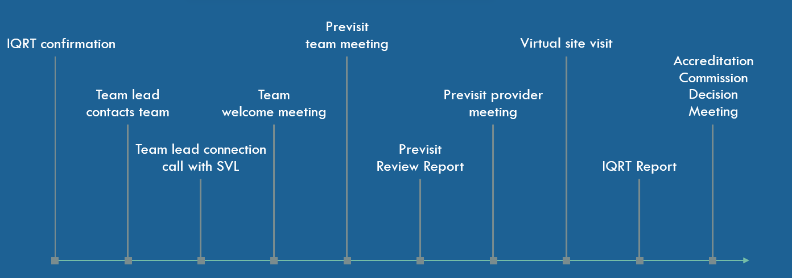
Initial Accreditation Review Team process

Slide 25
Initial Accreditation Report (IAR) outline
Institutional/Programmatic Overview, History, and Context
Standard 1: projected measures with plan for data and analysis
Standard 2: projected measures with plan for data and analysis
Documentation of P-12 Partnerships
Description and documentation of mutually beneficial P-12 partnerships(3b)
Description of partnerships that support high-need schools and promote equitable outcomes for all learners (4a)
Contextual Challenges and Planned Changes, Improvements, and Innovations
Program Capacity and Institutional Commitment (QAR Appendix C)
Evidence of Data Quality (detailed evidence or plans) (QAR Appendix E)

Slide 26
IAR Section 1
Institutional/Programmatic Overview, History, and Context
Key topics to address include (but are not limited to):
A brief history of the institution/programs seeking accreditation
(Program Specification Table - see next slide)
An explanation of the mission and/or rationale that shapes it
An overview of candidate and faculty numbers and demographics

Slide 27
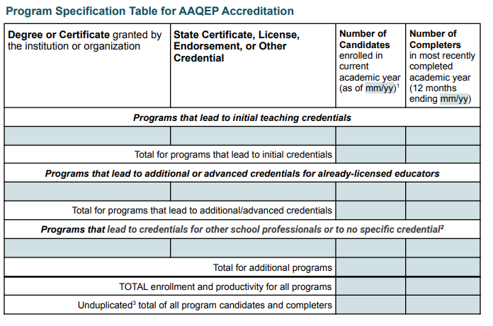
Program Specification Table
Re
Reminder - one or more measures for each aspect must be indicated for each program listed on the Program Specification Table.

Slide 28
AAQEP standards: Dimensions of quality

Slide 29
IAR Sections 2&3
Standard 1 projected measures with plan for data and analysis
Standard 2 projected measures with plan for data and analysis
describes the evidence sources or measures provider intends to use to support the aspects of Standards 1 and 2.
uses Aspect-Evidence Tables to specify proposed evidence sources and their alignment to aspects of Standards 1 and 2 (see next slide)
addresses each aspect explicitly for every program seeking accreditation
links or appends measures as applicable
shares plan for data analysis
Notes:
Standard 2 projected measures with plan for data and analysis

Slide 30
Standard 1
Program completers perform as professional educators with the capacity to support success for all learners
Candidates and completers exhibit the knowledge, skills, and professional dispositions of competent, caring, and effective professional educators. Successful candidate performance requires knowledge of learners, context, and content. Candidates demonstrate the ability to plan for and enact and/or support instruction and assessment that is differentiated and culturally responsive.

Slide 31
Aspects* of candidate/completer performance Readiness for effective practice (Standard 1)
1a. Content/pedagogical/professional knowledge 1b. Learners/learning theory, including social/emotional learning
1c. Culturally responsive practice
1d. Assessment and data literacy, use of data to differentiate
1e. Positive learning/work environment
1f. Professional dispositions/behaviors
* See the Guide to AAQEP Accreditation for each aspect’s full description.

Slide 32
Standard 2
Program completers adapt to working in a variety of contexts
and grow as professionals.
Program completers engage in professional practice in educational settings and show that they have the skills and abilities to do so in a variety of additional settings and community/cultural contexts.
For example, candidates must have broad and general knowledge of the impact of culture and language on learning, yet they cannot, within the context of any given program, experience working with the entire diversity of student identities, or in all types of school environments.

Slide 33
Aspects* of completer prof. competence & growth Engagement in professional practice (Standard 2)
2a. Engage local school and cultural community, caregivers, and families
2b. Culturally responsive practice with diverse learners in diverse settings
2c. Can develop productive learning environments in diverse contexts
2d. Support increasing P-12 students’ global/international perspectives
2e. Grow professionally / set goals / guide own professional development
2f. Collaborate for professional learning with colleagues
* See the Guide to AAQEP Accreditation for each aspect’s full description.

Slide 34
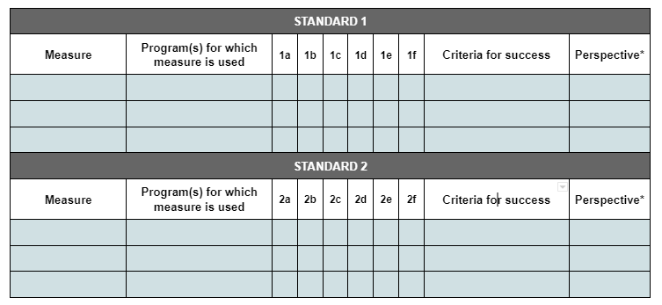
Sections 2&3: Aspect Evidence Table

Slide 35
Evidence set expectations
Reviewers confirm that overall, the evidence set for Standard 1 (but not necessarily for each aspect) contains:
● Multiple measures
● Multiple perspectives, including program faculty, P-12 partners, program completers, and employers
● Direct measures, including evidence of performance in a field/clinical setting appropriate to the program
The evidence set for Standard 2 will likely have some overlap with that of Standard 1 and place greater emphasis on evidence from completers’ practice in their professional roles.

Slide 36
IAR Section 4
Documentation of P-12 Partnerships
Description and documentation of P-12 partnerships that support clinical preparation of educators (3b)
Description of ways in which partnerships support high-need schools and promote equitable outcomes for all learners (4a)

Slide 37
Aspects* of quality program practices Program capacity (Standard 3)
3a. Coherent curriculum aligned to national or state standards
3b. Quality clinical experiences in documented, effective partnerships
3c. Stakeholder engagement in analysis, planning, improvement, etc.
3d. Admission/monitoring process linked candidate to success
3e. Internal quality assurance/continuous improvement (w/ good data)
3f. Capacity for quality and institutional commitment to the program
* See the Guide to AAQEP Accreditation for each aspect’s full description.

Slide 38
Aspects* of program engagement in system improvement Strengthening the P-20 system (Standard 4)
4a. Engages stakeholders to support schools and reduce disparities
4b. Supports diverse educator workforce/addresses state and local needs
4c. Supports completer career entry and growth
4d. Uses available evidence on completers for program improvement
4e. Meets relevant regulatory requirements
4f. Investigates effectiveness vis-à-vis institutional mission
* See the Guide to AAQEP Accreditation for each aspect’s full description.

Slide 39
Engaging with stakeholders
Stakeholders supporting your program…
Supporting your stakeholders’ needs…
3b
3c
4a
4b
Quality clinical experiences
Engage in data collection, analysis, & data quality issues (3e)
Work w/ stakeholders to support high needs schools
Meet local and state work force needs
Via effective partnerships
And in improvement and innovation
Reduce disparities in educational outcomes
Diversify participation via recruitment and support

Slide 40
Engaging with stakeholders
Consider the aspects involving stakeholders and complete the table addressing:
Sample Table
2. Consider a separate table for :
Candidate Focused Formal (MOU) Partnerships
Candidate Focused Informal Partnerships
Faculty Focused Partnerships in Community(ies)
Description of Partnerships (Specific) | When/Type (Observations, Clinical practice, etc.) | Value of partnership (How do you determine?) | Which program (content area, concept, initial program, etc.) | Timeframe (ongoing, semester, etc.) | AAQEP Standard Aspect 3b, 4a alignment

Slide 41
Engaging with stakeholders
Share:
How have you been documenting your work with stakeholders?
What changes to your process might you make to capture this evidence/documentation?
Partnerships Description of Partnerships (Specific) | When/Type (Observations, Clinical practice, etc.) | Value of partnership (How do you determine) | Which program (content area, concept, initial program, etc.) | Timeframe (ongoing, semester, etc.) | AAQEP Standard Aspect 3b, 4a alignment

Slide 42
IAR Section 5 Contextual Challenges and Planned Changes, Improvements and Innovations
Identifies new or emerging features of the programs being reviewed.
Describes any recent innovations, changes that are in process, program elements that will rely on novel evidence, or measures that differ from those described in the previous sections of the IAR (e.g., new assessments that are being introduced).

Slide 43
IAR Section 5 Contextual Challenges and Planned Changes, Improvements and Innovations
Sample Table
Contextual Challenge (Identified by provider) | Planned Changes | Planned Improvements | Rationale for Change/ Improvement | Timeframe for Completion | Prioritize (Why?)

Slide 44
IAR Sections 6 and 7
QAR Appendices C and E

Slide 45
IAR Section 6
(QAR) Appendix C: Program Capacity and Institutional Commitment
documentation of programmatic capacity for quality and institutional commitment to ensuring program quality
documentation takes the form of the required Appendix C that will appear (updated appropriately) in a provider’s subsequent Quality Assurance Report (QAR).

Slide 46
(QAR) Appendix C
In the IAR, the “Appendix C” is used to be consistent with the Accreditation (7 year) version self-study format.
Appendix C includes:
evidence of coherent curricula with clear expectations that are aligned with state and national standards, as applicable,(3a) and
evidence of how the program maintains capacity for quality reflected in staffing, resources, operational processes, and institutional commitment (3f).

Slide 47
IAR -- Appendix C: The first part of Appendix C documents the following dimensions of capacity related to aspects of Standard 3:
Focus
Purpose
The program’s capacity and the institution’s commitment to delivering quality preparation through:
curricula
faculty
facilities
fiscal support
student support services
student feedback, etc.
To inform an accreditation decision based on both quality and confidence
To make the case that program quality can be counted for a full 7-year term
Provide evidence for:
3a. Offers coherent curricula with clear expectations aligned with state and national standards, as applicable
AND
3f. Maintains capacity for quality reflected in staffing, resources, operational processes, and institutional commitment

Slide 48
IAR: Appendix C: Program Practice and Capacity
The second part of Appendix C documents --
Institutional commitment to the provider/program by showing that the resources and capacities devoted to it are at parity with those devoted to comparable programs within the institution, or with institutional norms, or with a comparable program in another institutional setting.
Note that parity does not imply absolute equality.

Slide 49
How do you investigate institutional commitment? Parity table (sample framework—not an actual exhibit)
Capacity Aspect | Preparation Program | Institutional Norm or Comparable Program | Analysis of Difference
Curriculum
Faculty (ranks, load)
Facilities
Fiscal support
Support services
Student feedback

Slide 50
Curriculum matrix sample
 |  | Appropriate state and/or national standards
Program Courses | Assessments (E.g., from clinical experiences, courses, etc.) | State Standards | e.g. InTASC standard # | SPA standard # e.g. NAEYC | AAQEP Standard and aspects (Standards 1 and 2)

Slide 51
Faculty qualifications table sample
Name | Current Rank/ Title | Terminal degree (Y/N) | Institution Granting Degree | Year of degree granted | Field/ specialization certification | Related qualifications; e.g. NBCT (link to CV) | Course numbers of regularly assigned courses | Years at provider | Other demographic characteristics (gender, race)
FACULTY
ADJUNCTS/LECTURERS
CLINICAL SUPERVISORS

Slide 52
IAR Section 7
(QAR) Appendix E: Evidence of Data Quality
Providers articulate their plans and rationale for how they attend to data quality. Some providers may also include their results to date.
Blank copies of locally developed instruments that will be used in relation to standards 1 and 2 should be appended to or linked in the report.

Slide 53
Aspects of data quality Evidence regarding assessments should be appropriate to type
Reliability
Reliable and reliably collected. How are raters calibrated?
Validity
How has/ might content validity be established?
Data Quality
Trustworthiness
For qualitative data, how is analysis done?
Fairness
Addressing bias – do measures work well for all candidates?

Slide 54
Initial Accreditation Review: Appendix E Data Quality
Appendix E
Providers that are at an early stage in some or all investigations of data quality may use this appendix to articulate their plans as well as their results to date.
Progress on any such plans can be addressed in future Annual Reports.
Appendix E should also include blank copies of locally developed instruments used in the report.

Slide 55
Sample framework (Ensuring Data Quality & Equity)
Table to summarize data quality work for proposal or as QAR appendix
Quantitative Measure:
Evidence (or plans) regarding validity
Evidence (or plans) regarding reliability
Evidence (or plans) regarding fairness
Qualitative Measure:
Evidence (or plans) regarding trustworthiness
Evidence (or plans) regarding fairness

Slide 56
Prioritizing your data quality work
For each measure, consider:
When was the last time you addressed validity and reliability?
Have standards recently changed (calling for realignment)?
Does it cut across multiple aspects or standards (i.e., measure provides you w/ substantial data on which decisions rely)?
Document how you have attended to or plan to attend to your measures.
e.g., Rationale, timeline, cycle, stakeholders

Slide 57
Appendix E: Evidence of Data Quality
Appendix E should answer the following questions:
What processes were or will be followed to investigate measures’ validity, reliability, trustworthiness, and fairness?
What processes were or will be followed to engage program faculty as well as internal and external stakeholders in evaluating instruments and in ensuring reliable (consistent) administration?
What has been learned so far, and how will future results be used by the programs?

Slide 58
Logistics of the Virtual Site Visit and Accreditation Decision

Slide 59
AAQEP site visits for IAR
Virtual review with two-three peer reviewers and a Local Practitioner (provider selected)
Teams give no judgment or recommendations; only collect and affirm evidence
Lead to timely (and transparent!) virtual decision meeting (2 to 3 months after virtual review)
Three Accreditation Commissioners make decision (based on IAR and QRT Report)

Slide 60
Role of Accreditation Commission
Same:
Types of decision
Timelines for accreditation process
Decision, recommendations
Virtual decision meeting
Different:
Short meeting AFTER the decision to offer suggestions and open to questions from the provider for feedback

Slide 61
Accreditation decision
The virtual decision meeting will take place 2-4 months after site visit
Team lead is invited to attend the meeting
Decision is effective immediately
Current policies regarding notations hold for the initial accreditation decisions
Follow timeline for QAR decision within 2-5 years; QAR site visit must occur within 5 years (state timeline may be applicable)

Slide 62
#AlwaysImprovingTogether

Slide 63
Click here for additional information.
Notes:
Registration has opened!

Slide 64
Thank you!
Please contact us:
Linda McKee l.mckee@aaqep.org
Sungti Hsu, s.hsu@aaqep.org
https://aaqep.org/iap

